Slide 1
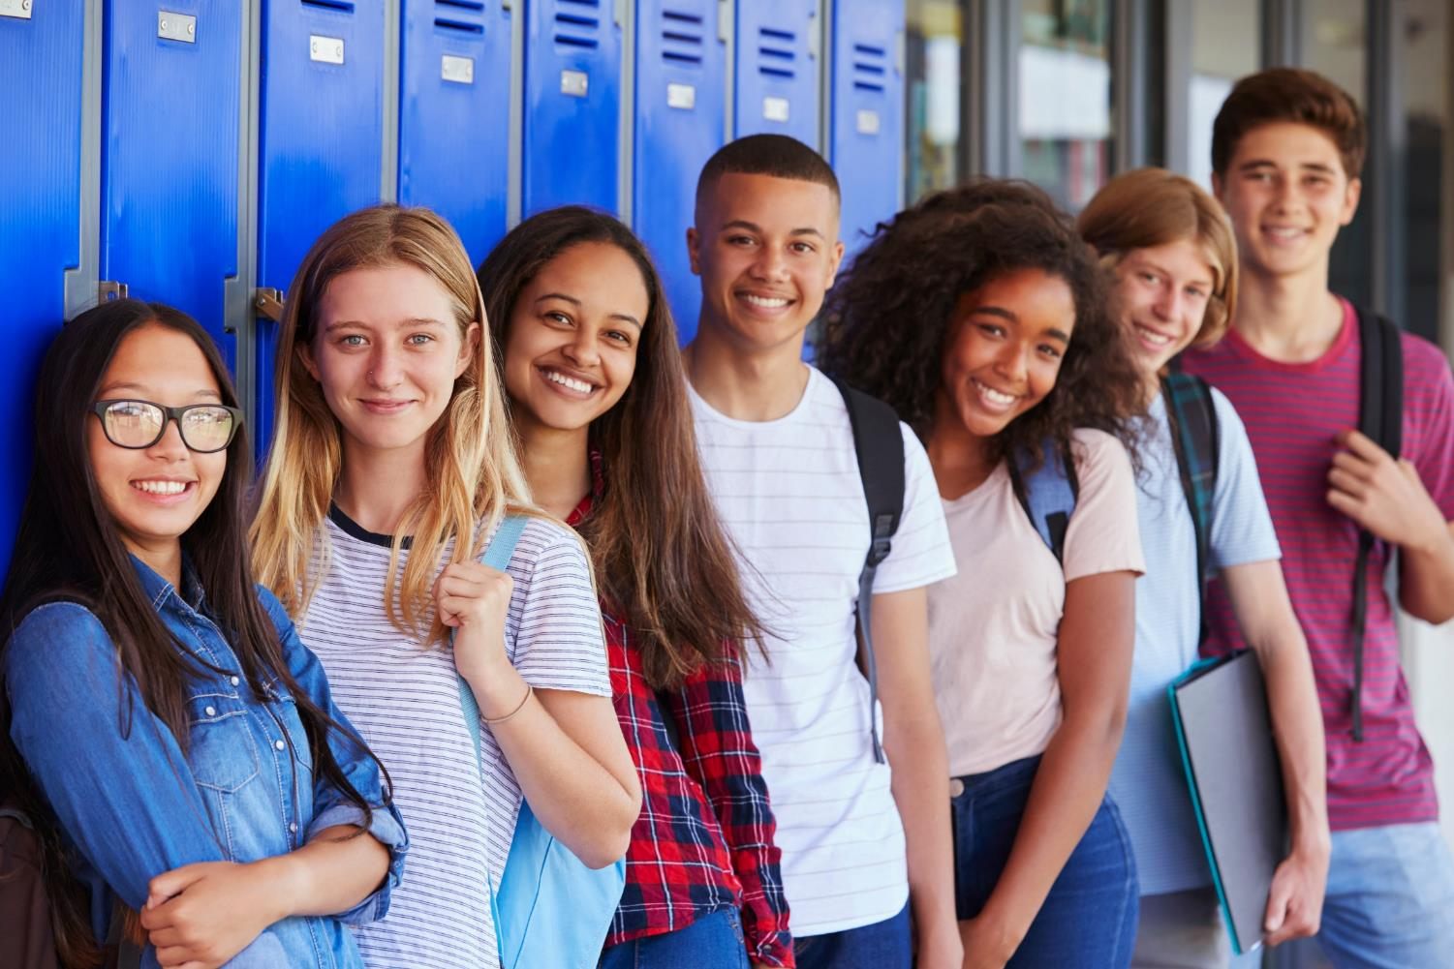
Be a PAL (Protect A Life) Food Allergy Awareness What are food allergies? Who has food allergies? How can you help people with food allergies?
© Food Allergy Research & Education (FARE), July 2023
© Food Allergy Research & Education (FARE), 2023, www.FoodAllergy.org
Food Allergy Research & Education (FARE), 2023
7
9
2
7
9

Slide 2
Food allergies are very serious, affecting 33 million Americans.
1 in 13 kids has a
food allergy.
That’s two kids in every classroom!
© Food Allergy Research & Education (FARE), July 2023
© Food Allergy Research & Education (FARE), 2023
Food Allergy Research & Education (FARE), 2023
2
7
9

Slide 3
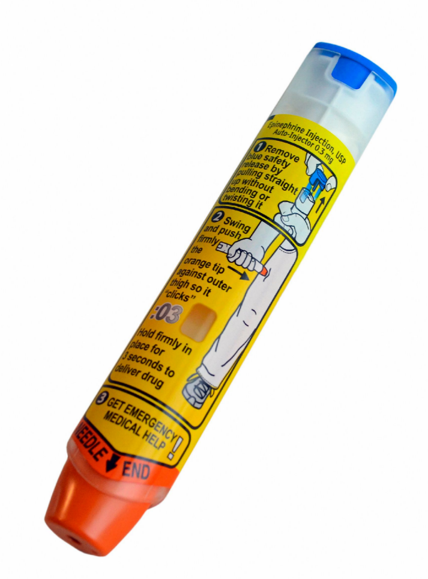
What is a food allergy?
What is a food allergy?
The immune systems in some people’s bodies act as if certain foods are harmful, even if other people can eat them every day.
If a person eats a food they’re allergic to, they can get very sick. This is called an “allergic reaction”.
There is medicine that can stop the allergic reaction and dangerous symptoms.
© Food Allergy Research & Education (FARE), July 2023
Food Allergy Research & Education (FARE), 2023
© Food Allergy Research & Education (FARE), 2023
3
2
7
9

Slide 4
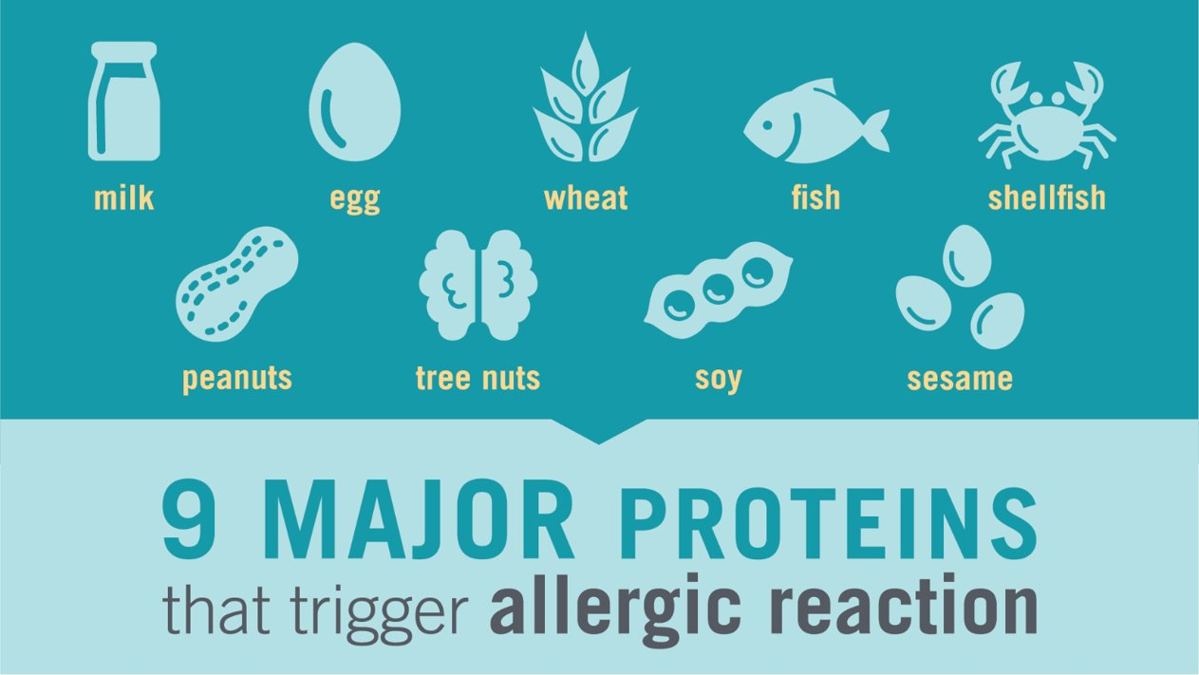
What foods cause allergic reactions?
People can be allergic to almost any food, but most food allergy reactions are caused by 9 foods:
5

Slide 5
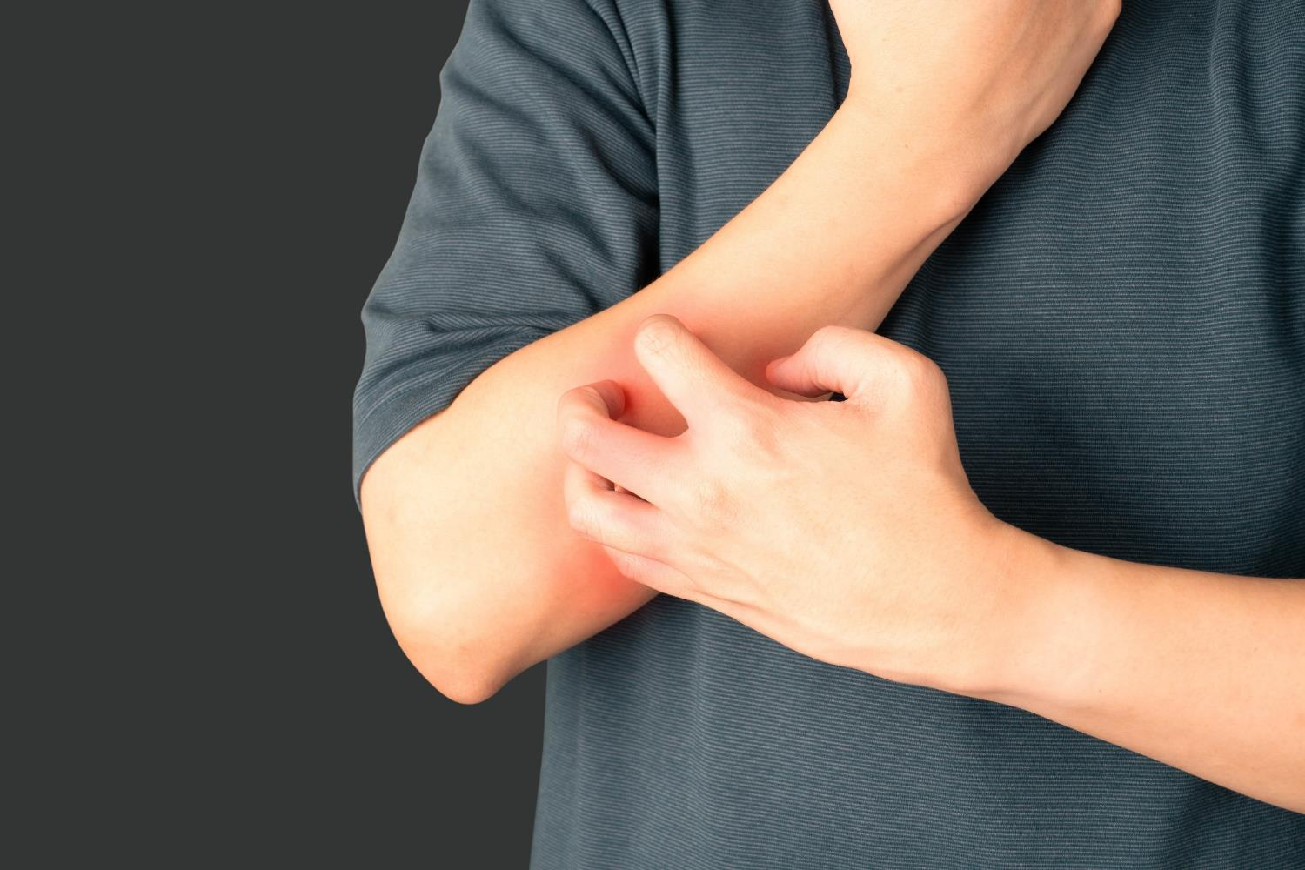
Food allergies can cause death
Anaphylaxis is a severe allergic reaction that usually comes on quickly and may cause death
A food allergy reaction sends someone to the emergency room every 10 seconds
Even if past reactions were mild, future reactions can be severe – so it is important to be prepared with their emergency medicine
© Food Allergy Research & Education (FARE), 2023
2
7
9
6

Slide 6
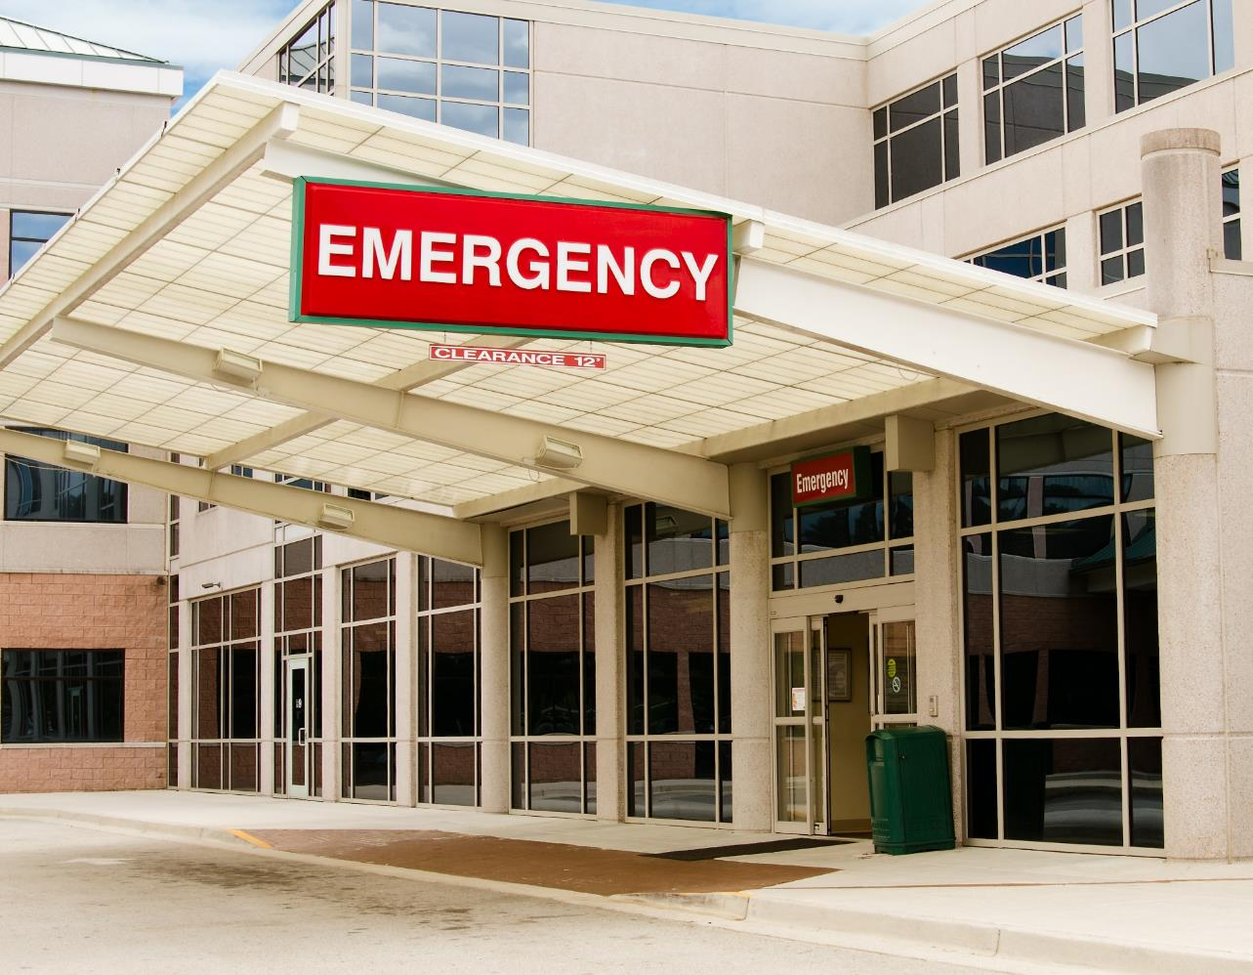
Many Have Already Experienced Severe Reactions
Almost 50% of children with food allergies have required treatment at the emergency room for their symptoms.
7

Slide 7
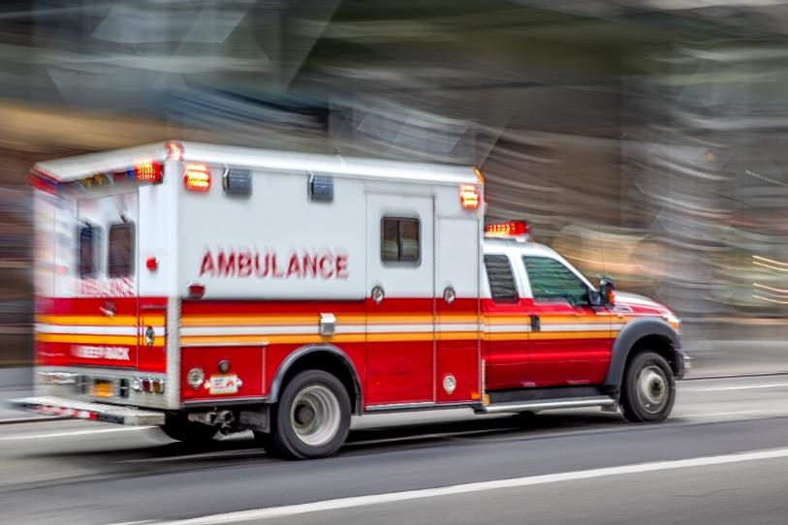
What would happen if my friend eats a food they are allergic to?
Some reactions can be more serious than others. Your friend could get very sick right away, even from just a tiny bit of a food they are allergic to.
They would need their medicine very quickly and may need to go to the hospital.

Slide 8
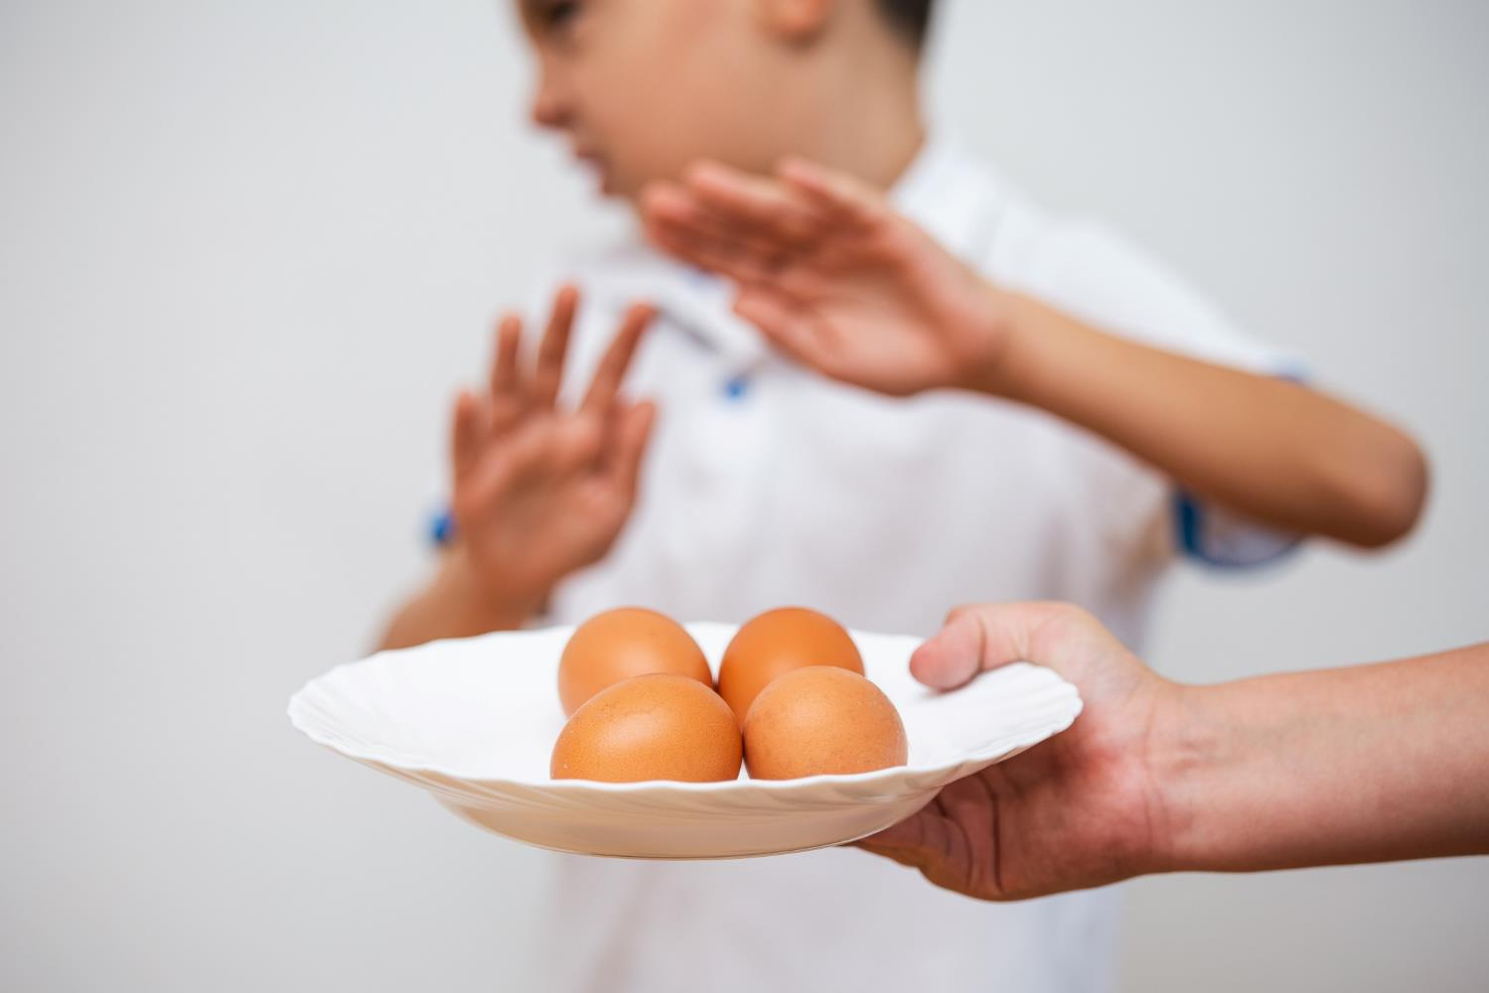
Can doctors cure food allergies?
There is no cure for food allergies.
The only way to keep from having an allergic reaction is to stay away from the food you are allergic to.

Slide 9
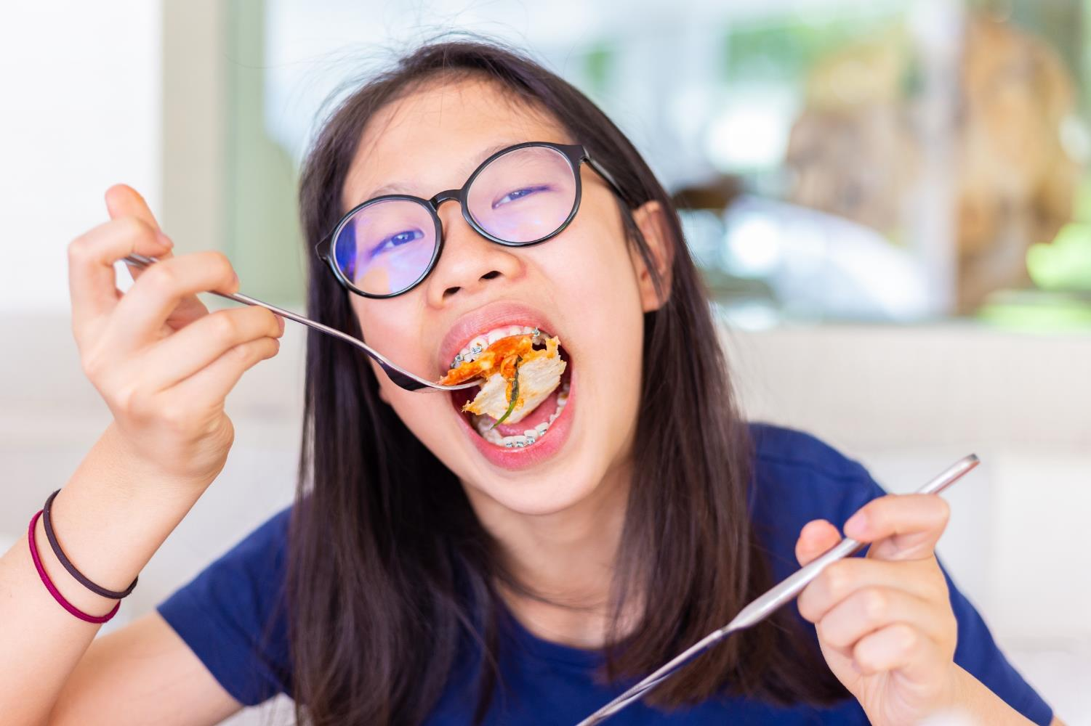
Learn how
to
Be a PAL
(Protect A Life)
to Friends with Food Allergies
© Food Allergy Research & Education (FARE), 2023

Slide 10
What can you do to Be a PAL?
Know that food allergies are very serious and can cause death.
Don’t share food with friends who have food allergies.
Wash hands after eating.
If a friend with food allergies feels or looks sick, get help right away!

Slide 11
What would you do?
Your friend, Stephen, has a food allergy.
As you and Stephen walk out of the cafeteria, he says his stomach hurts.
You ask him to work with you on a project, but he says he wants to lie down.
He says it feels like there is something stuck in his throat.
© Food Allergy Research & Education (FARE), 2023

Slide 12
A PAL would…
Get an adult right away or dial 911!

Slide 13
What would you do?
You and Stephen are hanging out with another friend, Max.
Max offers Stephen a chocolate chip cookie from his backpack.
Stephen says, “No thank you, I have a food allergy.”
Max says, "Come and have some, it’s probably OK.”
© Food Allergy Research & Education (FARE), 2023

Slide 14
A PAL would…
Tell Max that even one bite of the wrong food could make Stephen sick.
Wait to have snacks until later or ask an adult to help find a snack that is safe for him.

Slide 15
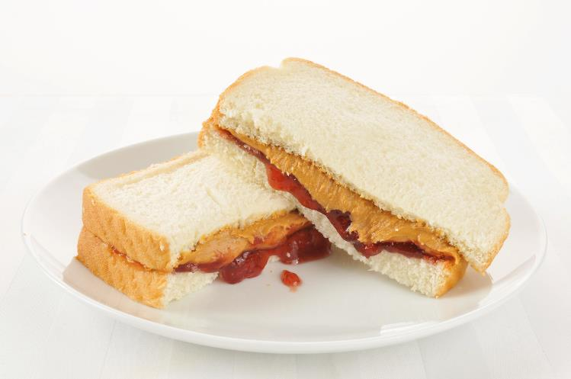
What would you do?
Two kids in your class are allergic to milk and peanuts.
Before school, you ate peanut butter toast and drank a glass of milk.

Slide 16
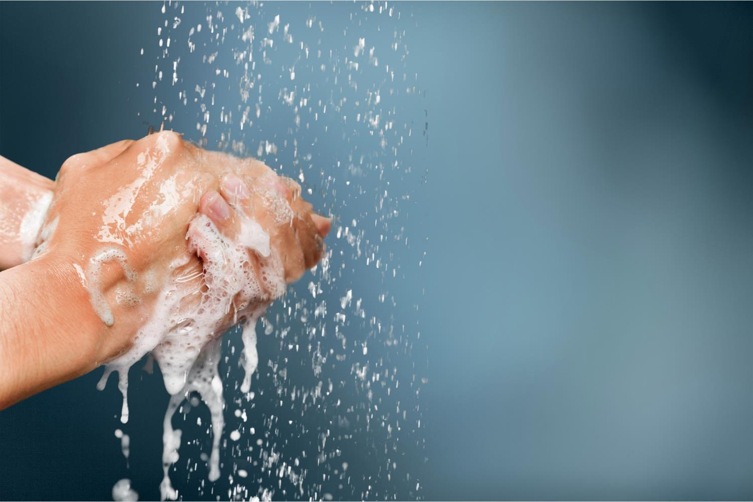
A PAL would…
Wash your hands and face with soap and water before leaving for school.

Slide 17
Learn more and get involved:
www.foodallergy.org/teens
© Food Allergy Research & Education (FARE), 2023

